Slide 1
Network Security of 5G Ecosystems
Ege HARPUTLU, Network & Cybersecurity Engineer

Slide 2
AGENDA
Introduction to 5G Networks
Weaknesses of 5G Ecosystems
Modern Defense Techniques for 5G Ecosystems
Popular Attacks (with 2 hack simulation DEMO projects)
Nokia’s Security Solutions

Slide 3
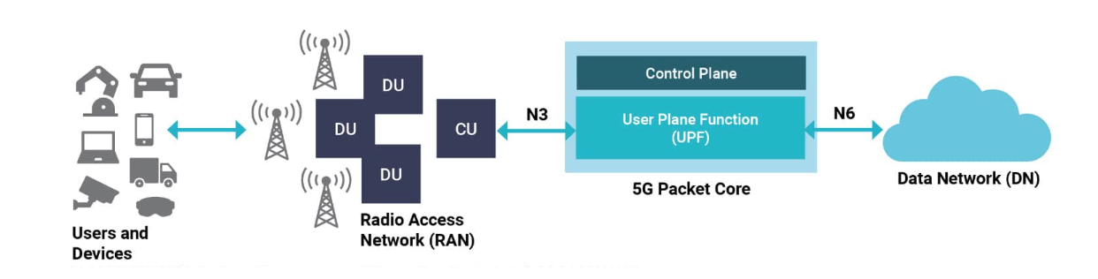
WHAT IS 5G?
Autonomous systems, smart cities, IoT, and more…

Slide 4
GENERAL CONCEPTS IN 5G ECOSYSTEMS

Slide 5
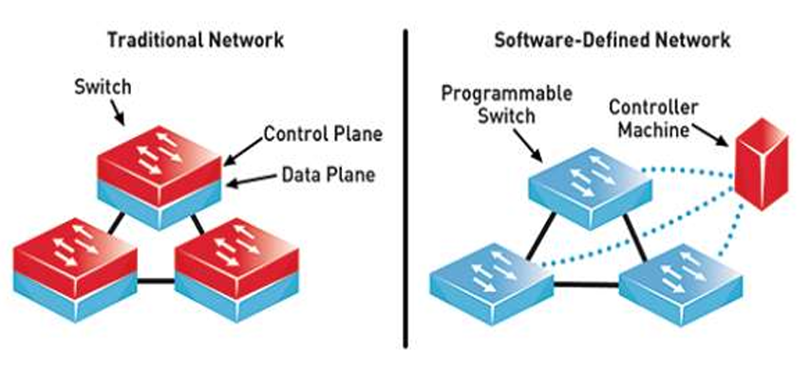
Software defined network (sdn)

Slide 6
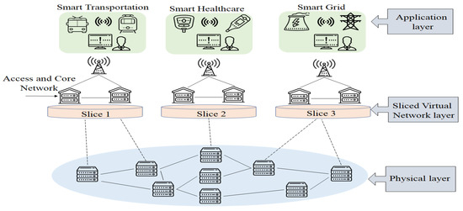
NETWORK SLICING

Slide 7
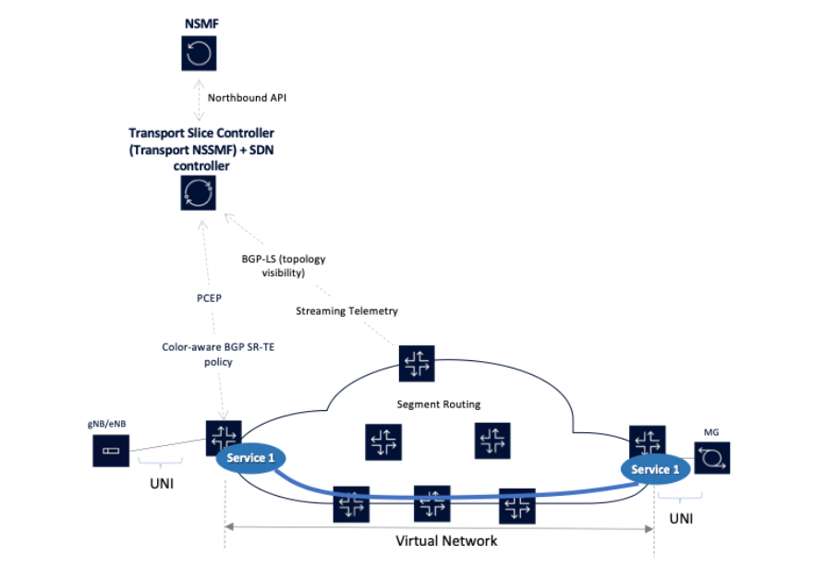
AN EXAMPLE: HOW A TRANSPORT SLICE WORKS ?

Slide 8
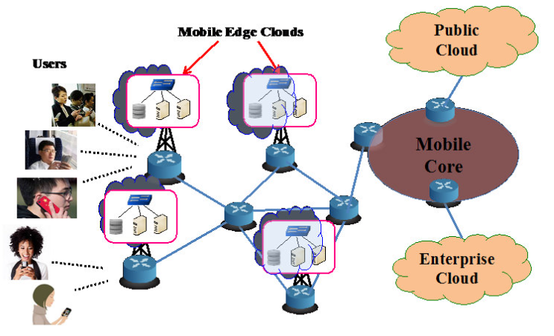
EDGE COMPUTING (mec)

Slide 9
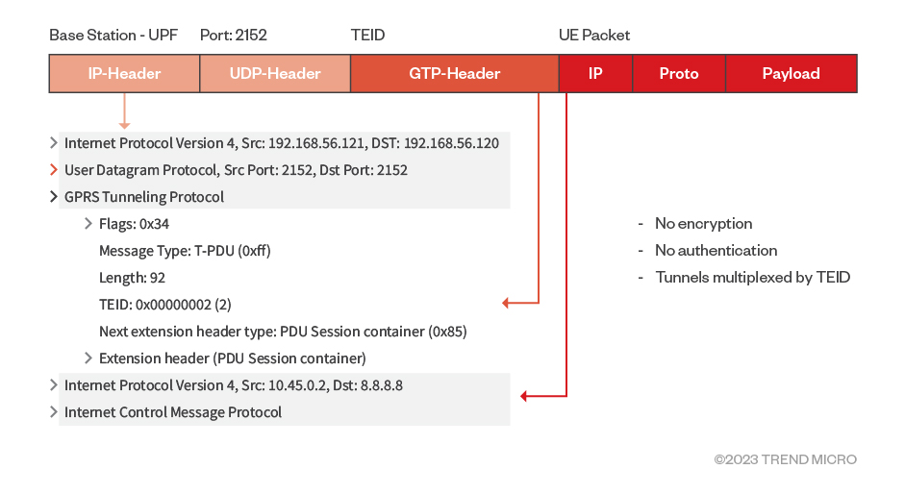
GTP-U (General Packet Radio Service (gprs) tunNelıng protocol – user plane)

Slide 10
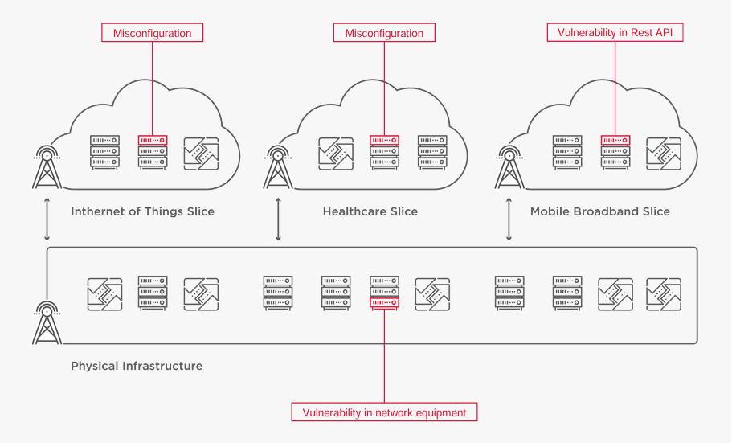

5G-BASED network SECURITY WEAKNESSES
Expanded Attack Surface (entry points to attack like IoT, SDN, MEC, cloud, API, physical hardware)
Unfamiliar Protocols & Technologies
GTP-U in backhaul
Security Lag vs. Ultra-Low Latency
Initial Connection Vulnerabilities (RAN)
Slice Misconfiguration Risks

Slide 11
Are TRADITIONAL Security Measures STILL Enough?
Most traditional defense systems assume trusted internal zones.
SDN environments introduce new, dynamic attack surfaces — static rules can’t adapt.
The device nodes in the edge computing or IoT devices generally have no security are rarely patched / updated.
Quantum computing can break classical encryptions.

Slide 12
This is why we need a paradigm shift — MORE MODERN AND future-PROOF METHODS TO SECURE 5G ECOSYSTEMS…

Slide 13
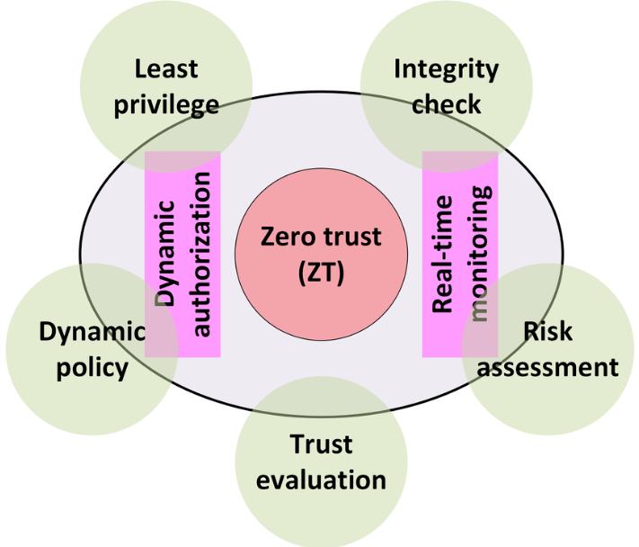
ZERO TRUST SECURITY
We should never trust anything- not users, devices, or services.

Slide 14
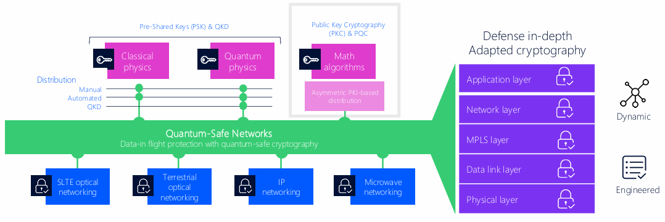
QUANTUM-SAFE NETWORks
Robust against quantum computing based attacks.
Can be used in initial connections (RAN) in 5G networks.

Slide 15
POPULAR ATTACKS APPLIED ON 5G ECOSYSTEMS

Slide 16
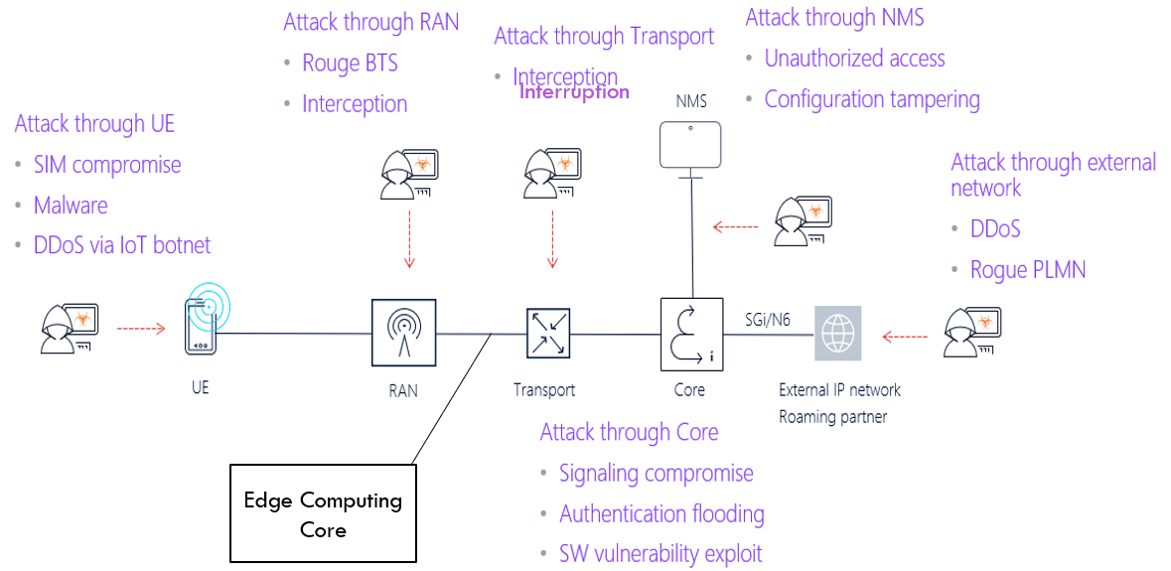
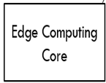
GENERAL THREAD-LANDSCAPE

Slide 17
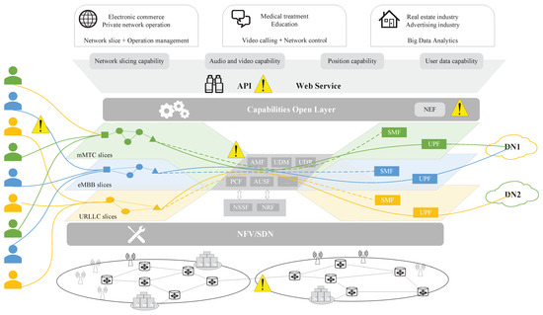
SECURITY THREADS DURING SLICE OPERATIONS
SMF

Slide 18
POPULAR ATTACKS IN 5G ECOSYSTEMS
DDoS on Network Slices
Rogue Base Stations (Fake gNodeBs)
Man-in-the-Middle over EC
Location Tracking via Signaling Exploits
Signaling Storms
Cross-Slice Attacks (Lateral Movement)
AI/ML Model Poisoning (e.g., FLPA)
IP Fragmentation Attacks

Slide 19
Federated Learning Poisoning Attack

Slide 20
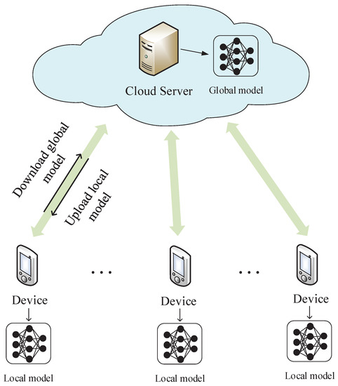
FIRST: WHAT IS Federated Learning ?

Slide 21
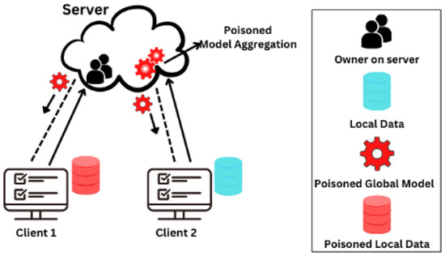
What Is federated learning poisoning attack ?

Slide 22
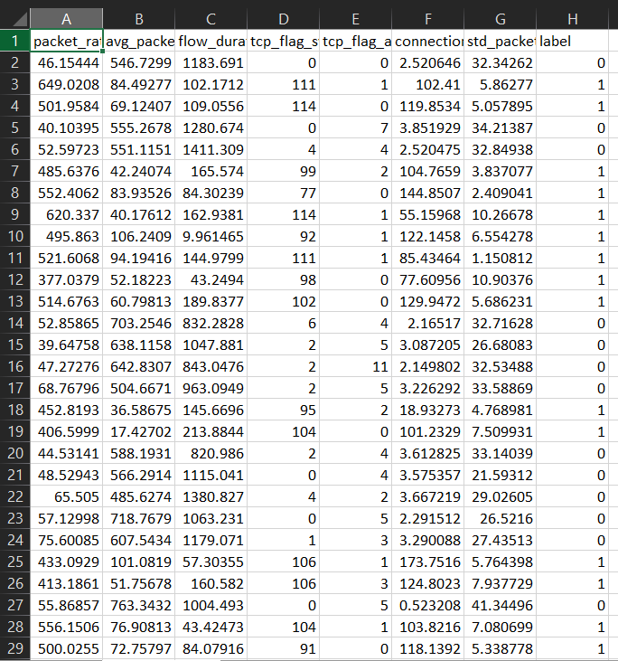
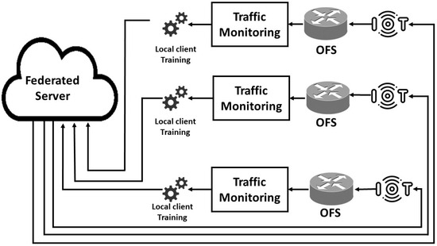
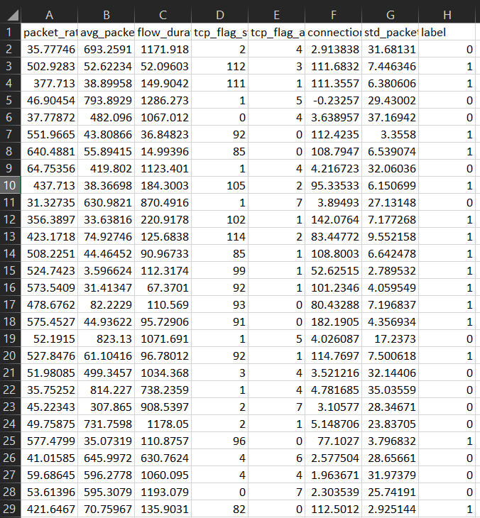
My simulation set-up
GOAL: Test whether a poisoned client can degrade the performance of a DDoS detection model in FL.

Slide 23
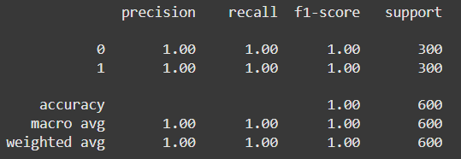
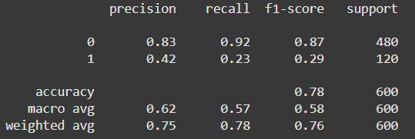
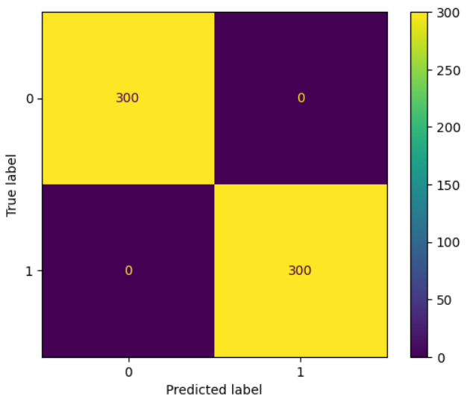
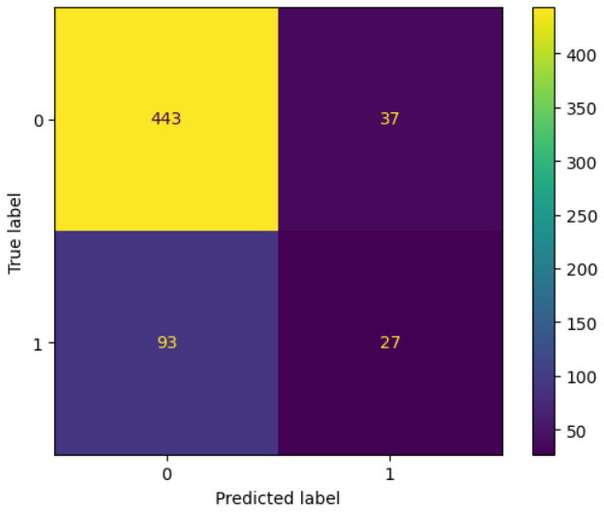

FLPA EFFECT

Slide 24
DefenSe Strategies against FLPa
Client-side validation: Check update consistency before aggregation.
Robust aggregation techniques (e.g., Krum, Trimmed Mean).
Behavioral monitoring of FL participants over time.
Local model accuracy check

Slide 25
IP FRAGMENTATION ATTACK

Slide 26
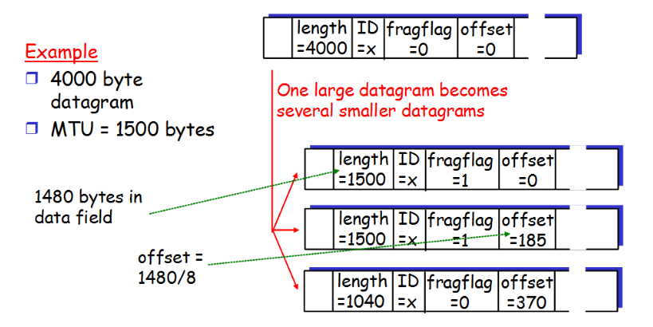
FIRST: WHAT IS IP FRAGMENTATION ?
Splits large packets into smaller fragments due to MTU limitations on the path.
Each fragment carries a portion of the original payload, reassembled at the destination host.

Slide 27

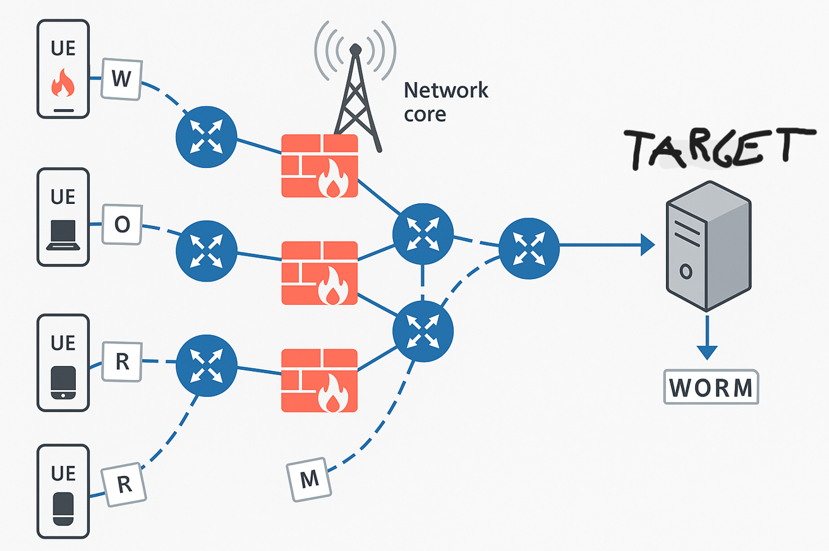
WHAT IS IP FRAGMENTATION ATTACK ?
Sending a harmful payload via HTTP, UDP, ICMP, etc. by fragmenting it to bypass
Denial of Service (DoS) by sending very small fragments with false offsets to confuse target

Slide 28
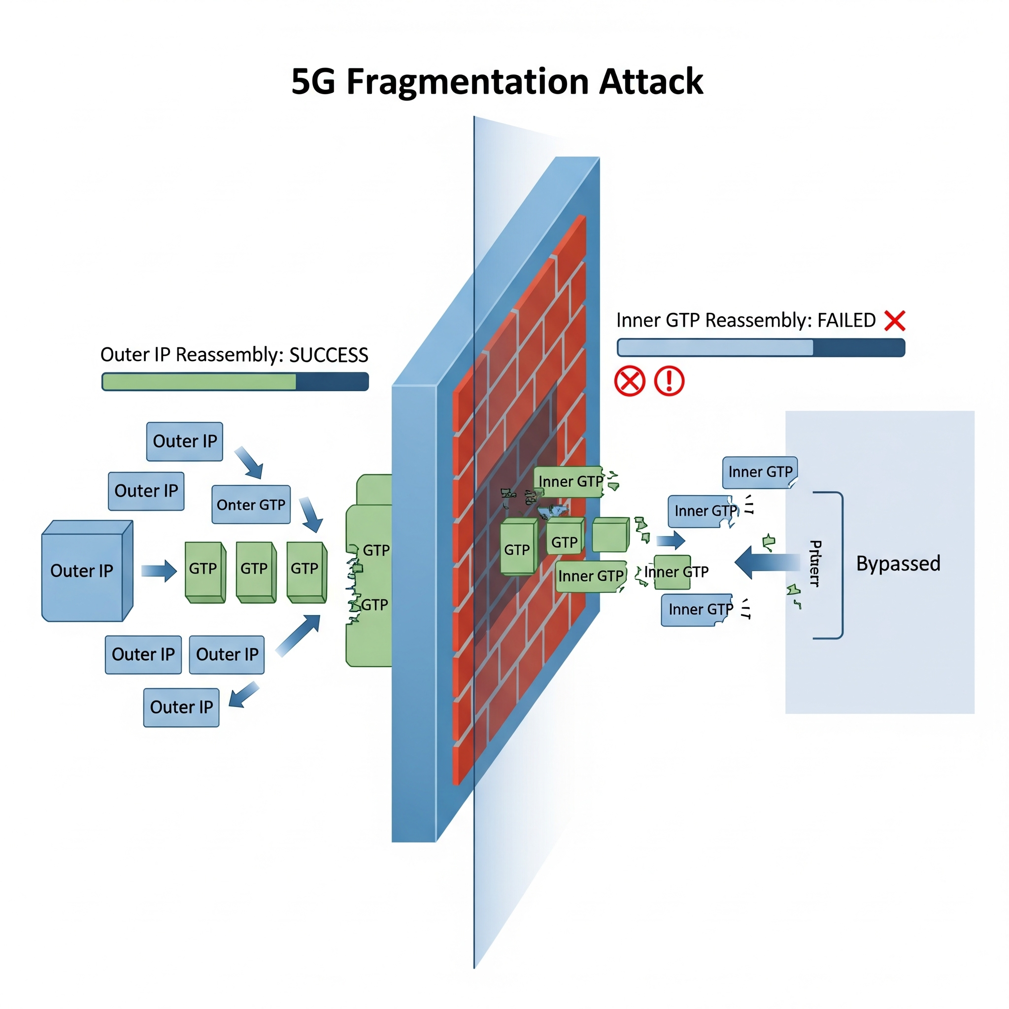
IP FRAGMENTATION ATTACK IN 5G-BASED NETWORKS
When outer IP packets are not fragmented, but inner IP payloads in the GTP headers are fragmented; some reassemble-aware security systems do not see the inner IP fragments since they are focusing on outer IPs.
Sometimes no reassembling due to ultra-low latency and high sped issues.
Outer IP → Outer GTP → Inner IP (fragment #1)
Outer IP → Outer GTP → Inner IP (fragment #2)
Outer IP → Outer GTP → Inner IP (fragment #3)

Slide 29
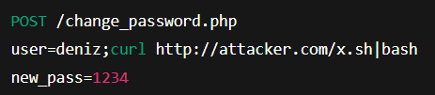
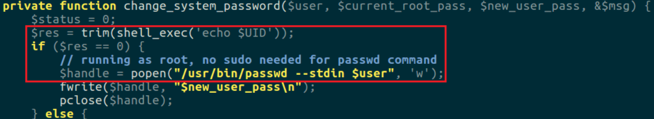
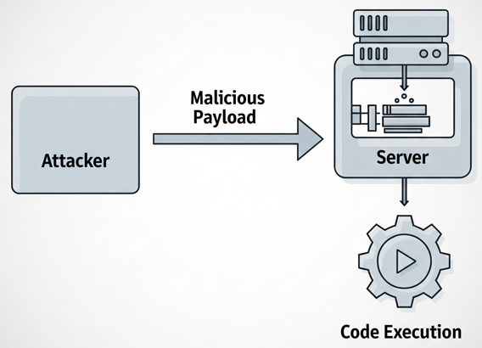


REMOTE CODE EXECUTION (RCE) VULNERABILTY ?

Slide 30
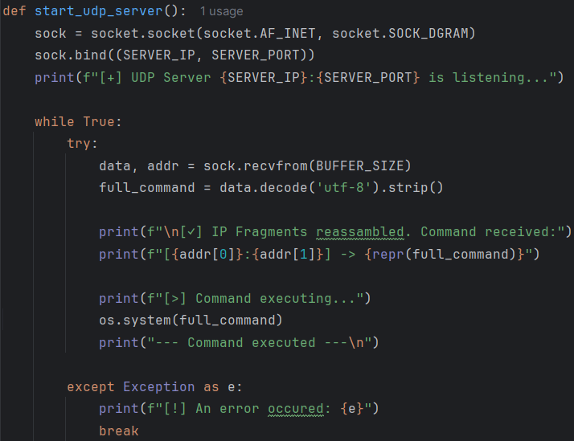

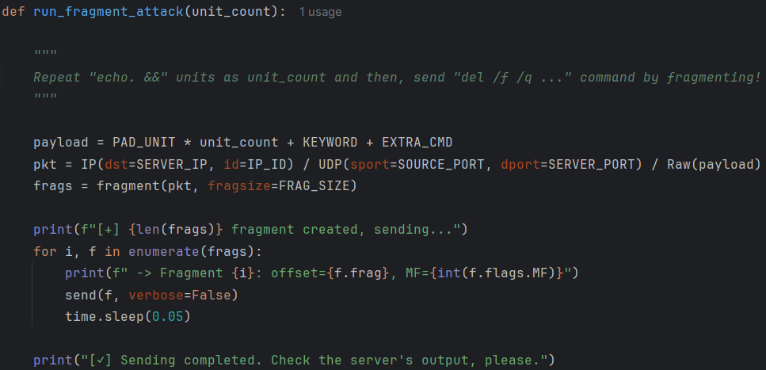




MY ATTACK SIMULATION
Intermediate Security System
GOAL: To delete a critical file of a machine with RCE vulnerability, bypassing firewall or other security systems.
Notes:
netstat -ano -p udp | findstr :12345 taskkill /PID 2928 /F

Slide 31
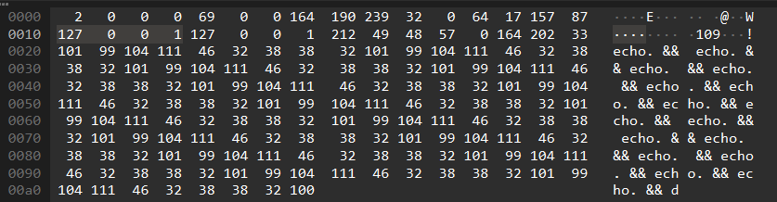
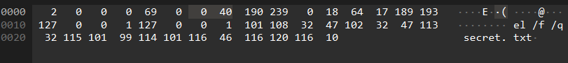


WIRESHARK ANALYSIS

Slide 32
DefenSe Strategies against IPF Based ATTACKS
Deep IP / GTP Packet Reassembly at Edge & Core Security Systems
Drop Suspicious or Incomplete Fragments: Filter packets with abnormal fragmentation patterns (e.g., MF=1 with no final MF=0, or constant Fragment Offset = 0).
MTU Hardening in 5G Networks: Dynamically tune conservative MTU values per slice to reduce fragmentation

Slide 33
NOKIA SOLUTIONS

Slide 34
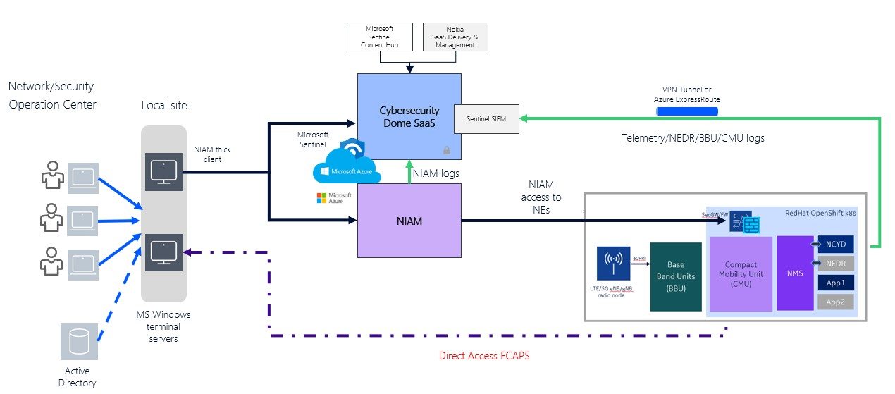
NOKIA’S SOLUTION
Nokia protects 5G networks (esp. RAN and telco cloud) with a telecom-aware Extended Detection and Report (XDR) security system (from the Netguard family). It collects all telemetry in Microsoft Sentinel. With Cybersecurity Dome (SaaS), it links and understands this data in the 5G context and explored patterns if exist. Then it takes automatic actions using NIAM, firewall, etc.
(Config, ticketing, monitoring,
Response)
(Central and Derived
Logs/Alarms)
Session logs
(remote monitoring of 5G network)
(source logs)
(Cloud/
DB)
(User-role-config-changes)
RAN management/config
RAN + Telco
(part of 5G network)
(authority)

Slide 35
THANK YOU FOR LISTENING 🙂
ANY QUESTIONS ?

Slide 36
RESOURCES & REFERENCES
Nokia (nokia.com)
ChatGPT

